Slide 1

Columbia School of General Studies
Content Strategy

Slide 2

School Overview
GS Undergraduates
Postbaccalaureate Premedical Program
Joint Program with List College at the Jewish Theological Seminary
Dual BA Program Between Columbia University and Sciences Po
Joint Bachelor's Degree Program Between City University of Hong Kong and Columbia University
Dual BA Program between Trinity College Dublin and Columbia University
Dual Degree Program between Tel Aviv University and Columbia University

Slide 3
School Overview
Current Students - 2,747 (as of Spring 2022)
1,637 - Undergraduate Degree Seeking (Average Age: 28)
787 - Dual / Joint Degree Programs (Average Age: 21)
323 - Postbac Premed Program (Average Age: 30)
Alumni - 20,000+
Plus withdrawals
Prospective Students - Countless

Slide 4
Organizational Goals
Attract, educate, and support the best and brightest nontraditional students and students who follow a nontraditional path in pursuit of their undergraduate education
Develop a world-class alumni and development organization
Maintain the reputation of the Columbia University Postbaccalaureate Premedical Program as the best program of its kind in the country
Enhance the academic experiences of our students
Position the School of General Studies as the preeminent college in the country for nontraditional students
Full List: gs.columbia.edu/content/mission-vision-goals

Slide 5
Audience Overview and Goals
Current Students
Alumni
Prospective Students
Staff
Faculty
Trustees
Media
Family Members

Slide 6
Communications Channels
5 websites
8 newsletters (2 weekly and 6 monthly)
10 active social media accounts
Student Success Portal
Staff Intranet
Admitted Students Portal

Slide 7
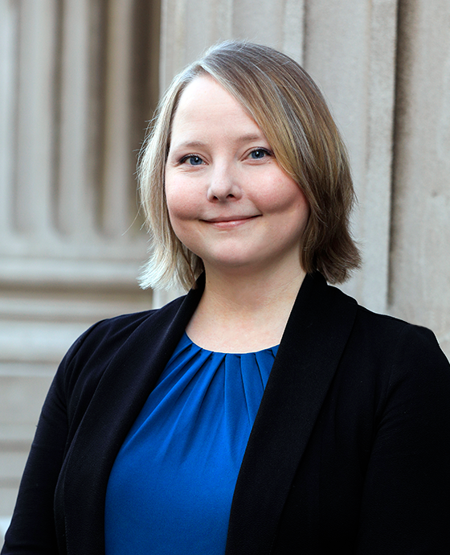
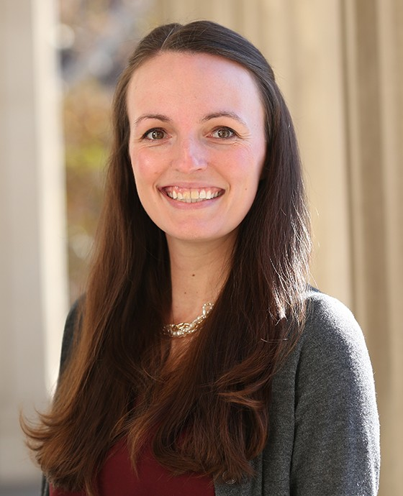
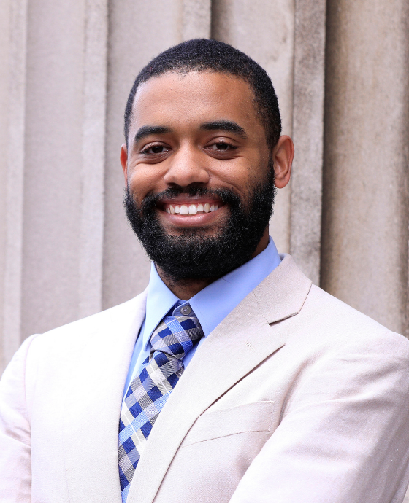

Team Overview
Christina Gray
Associate Director of Communications
Natalie Jankowski
Associate Director of Communications
Ryan Bermudez
Communications Officer
Lucky Person
Content Officer

Slide 8
Communications Goals
Distribute important dates, deadlines, announcements, and opportunities to current students in a timely, digestible format to support improved outcomes and experience
Distribute important dates, deadlines, and event updates to prospective students in a timely, digestible format to support growth in pool of highly-qualified applicants
Increase the visibility of and improve the reputation of Columbia GS for internal and external audiences
Help improve sentiment toward GS among current students and alums
Increase internal staff awareness of GS student stories

Slide 9
Communications Challenges
Diverse, distributed audiences
Overlapping timelines for current and prospective students
Limited organic reach
CAPACITY

Slide 10
Audience Content Overview
Current Students (dates/deadlines, announcements, events, news, profiles)
Alumni (events, news, profiles)
Prospective Students (dates/deadlines, events, news, profiles)
Staff (news, profiles)
Faculty (news, profiles)
Trustees (news, profiles)
Media (news, profiles)
Family Members (events, news, profiles)

Slide 11
Content Strategy
Simplify promotion for key dates and deadlines
Streamline data and asset collection process
Centralize content management and tracking
Publish a higher volume of engaging content
Identify content themes that can be leveraged to create campaigns

Slide 12
Content Approach
Plan
Review
Simplify
Delegate
Aggregate
Repurpose
Distribute
Review

Slide 13






Content Tools

Slide 14
Content / Process Overview
Notes:
Share Screen

